Slide 1



From Policy to Practice
How Political Participation Frameworks Shape New Europeans’ Political Engagement
Başak Yavçan, PhD, Head of Research
Migration Policy Group
Chiara Agrillo, Research Assistant
Migration Policy Group
Anoushka Gautam, Research Assistant
Migration Policy Group

Slide 2
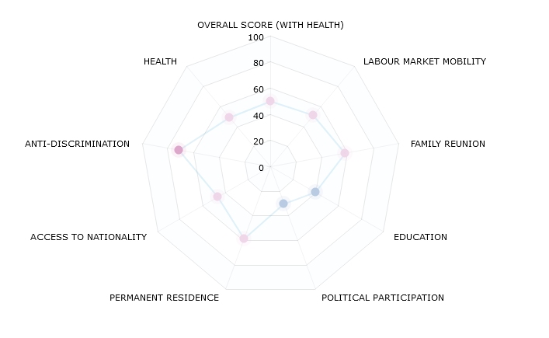
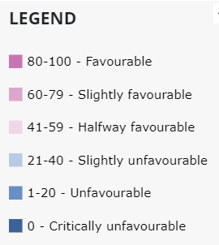
MIPEX INTEGRATION DIMENSIONS (Average of 52 countries)

Slide 3



Why does this matter?
Political participation is a cornerstone of democratic governance and a key dimension of social and political integration.
Migrants’ political participation is central to debates on democratic legitimacy, representation and democratic resilience.
Across the EU, opportunities for political participation remain highly uneven shaped by differences in:
  Citizenship regimes
  Voting rights
  Civic freedoms
  Institutional practices

Slide 4
Introduction
This report sheds light on the relationship between national political participation policies and migrants’ political participation outcomes across 22 EU Member States.
  It combines the Political Participation Policy Index with administrative and survey-based indicators to assess how policies are associated with:
    Naturalisation
    Electoral participation
    Non-electoral engagement
    Political attitudes

Slide 5

Outline
Our contribution
The Political Participation Policy Index
Link between policy & outcomes
Data Gaps & Landscape
Data & Methodology
Analysis & Findings
Recommendations

Slide 6
What is our contribution?
Theory
Demonstrating the central role of institutional and policy contexts in shaping political engagement.
Proposing the newly developed index as a robust comparative measure of political participation frameworks
Contributing to the literature on political participation as a multidimensional process extending beyond voting to include non-electoral engagement and subjective dimensions.
Policy
More inclusive political participation frameworks are associated with higher engagement overall.
BUT formal rights alone are not sufficient.
Rights should be combined with active encouragement, civic education, and support for migrant-led civil society.
Addressing the data gaps is essential for better diagnostics and policy development

Slide 7
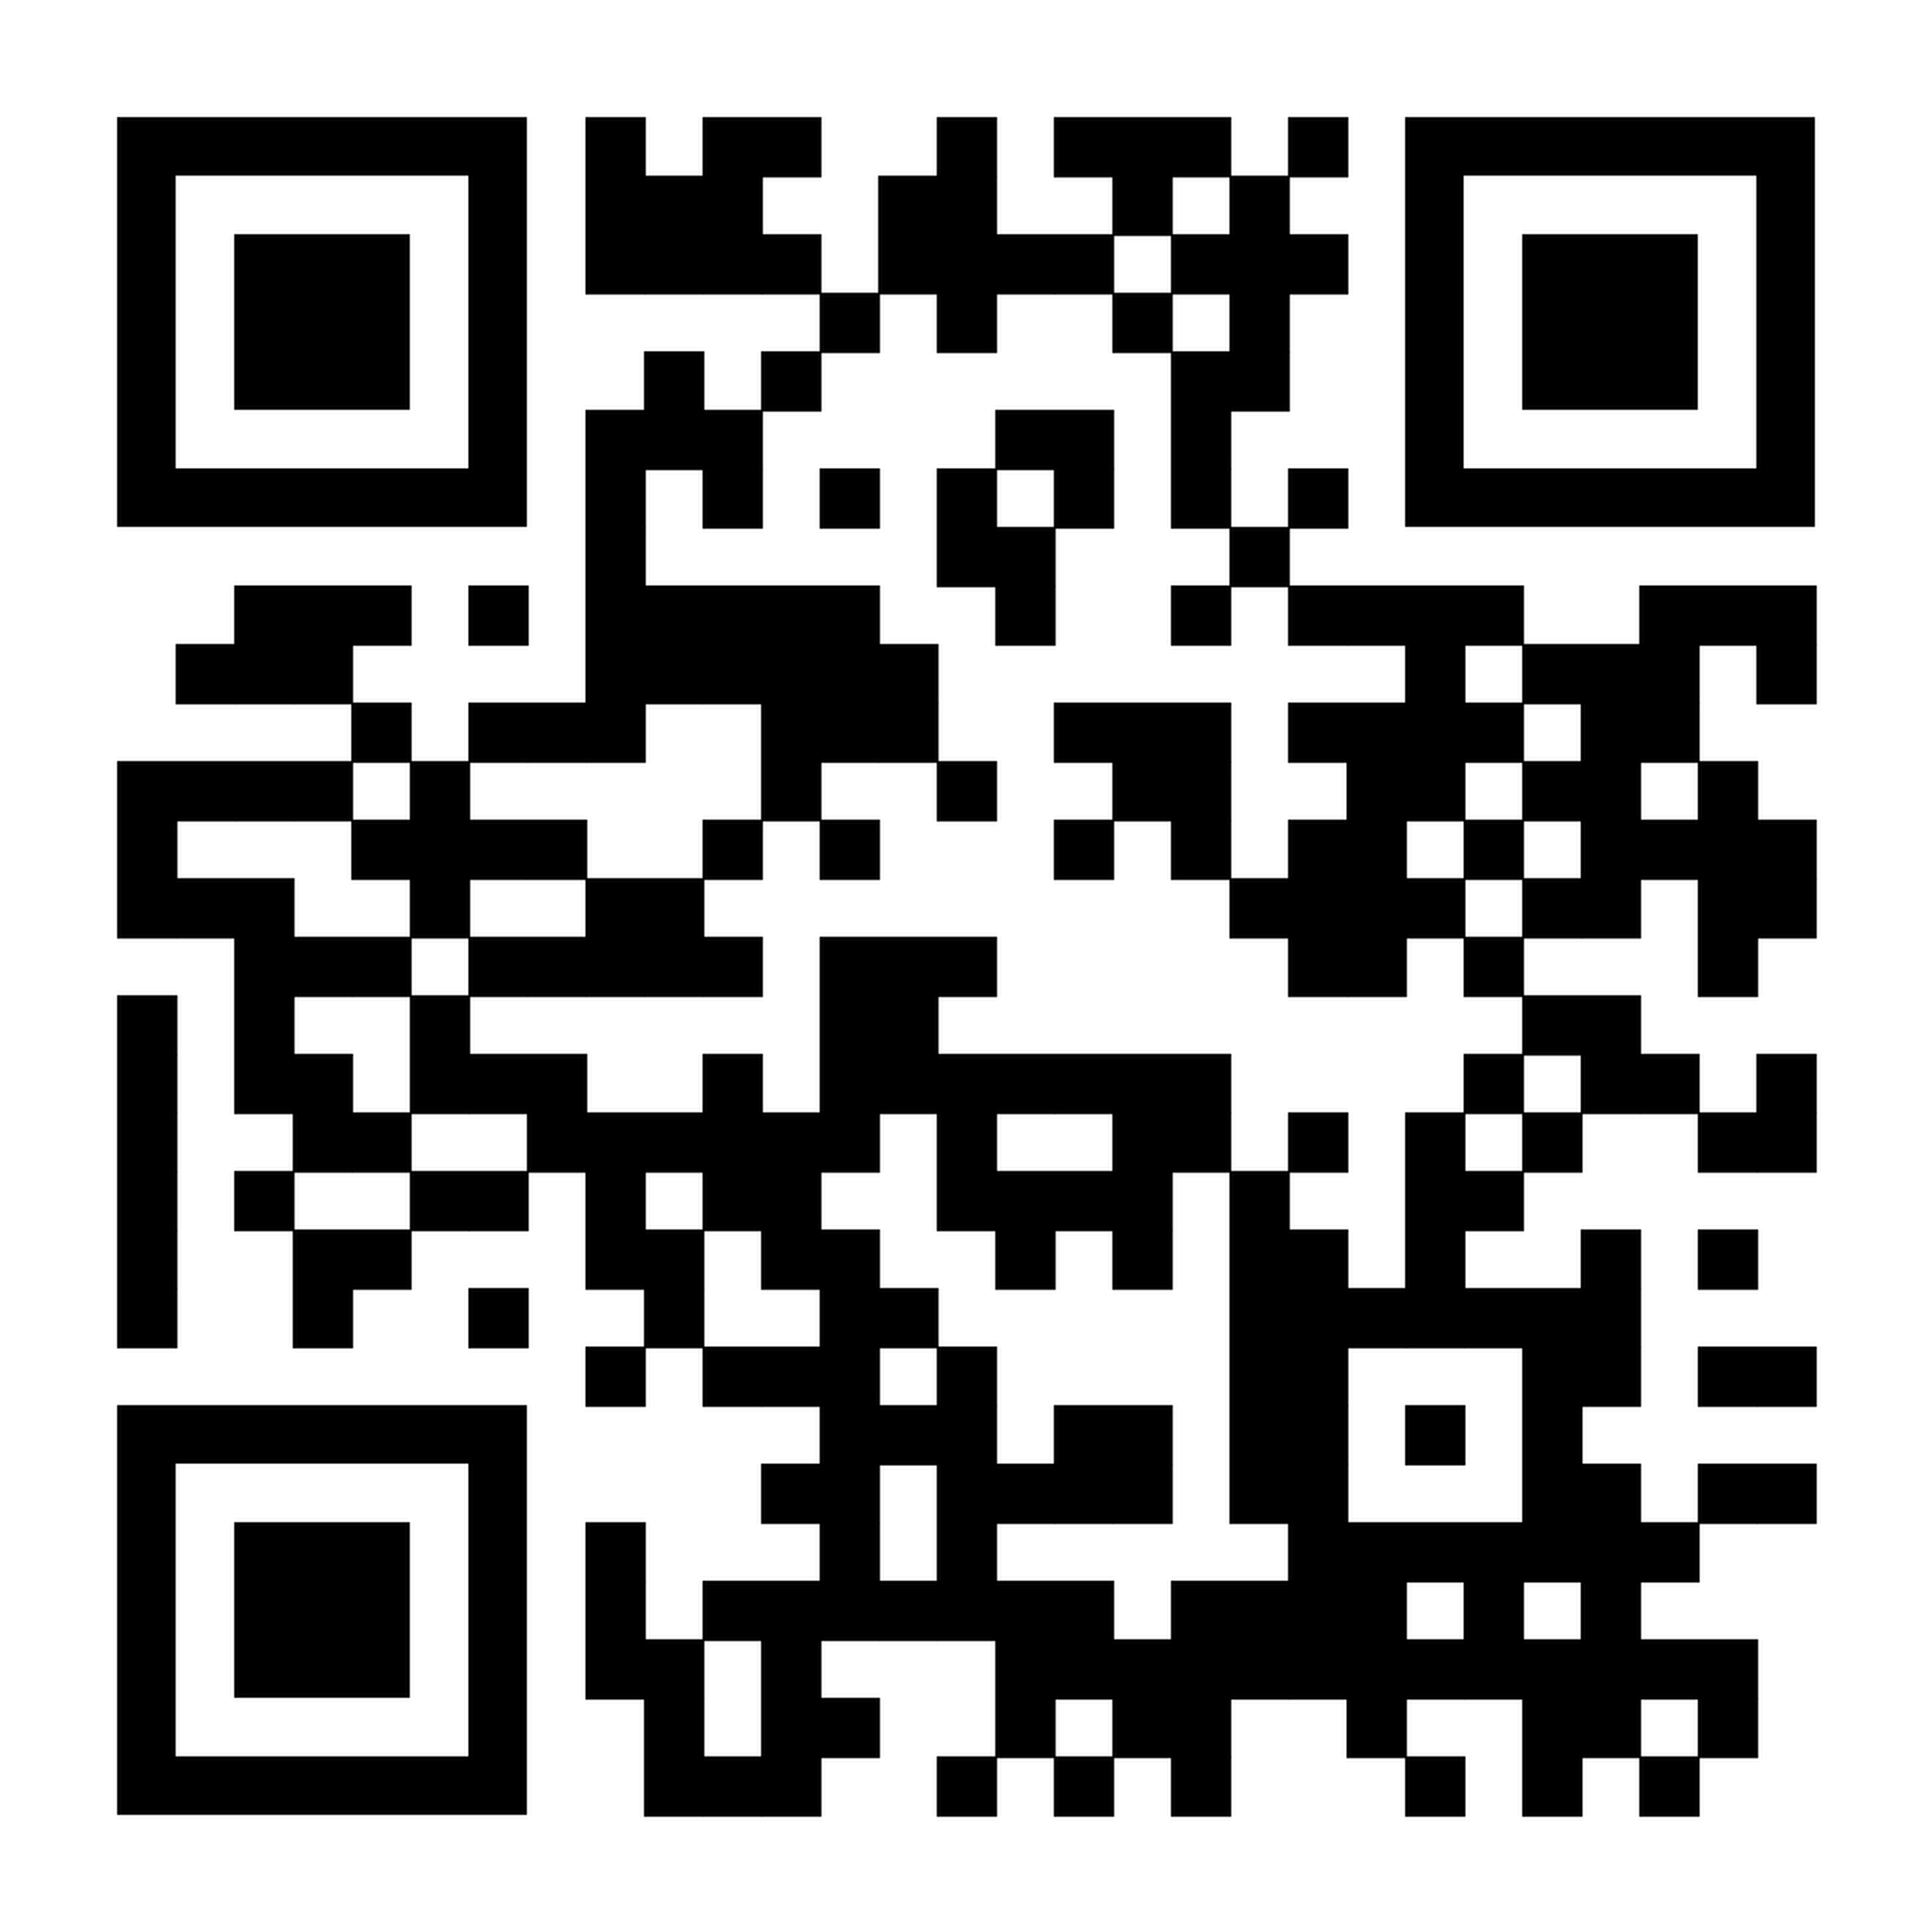
What is the Political Participation Policy Index?
Comparative tool for assessing national models of newcomers’ political participation across the EU, with a broad understanding of political participation going beyond electoral processes to include collective and unconventional forms of engagement at national and local levels.
8 key dimensions, 29 indicators, 27 Countries, measuring policies, practices, and outcomes:
National strategy to increase political participation
Promotion of Representation in Political Life
Full political and civil Rights through Citizenship
Representation of Migrant-Led Civil Society
Right to vote in elections for foreign citizens
Enabling Collective Civic Engagement
Encouragement to vote
Civic Education for a Diversifying Society

Slide 8
Link between Policy and Outcome
Political participation includes electoral and non-electoral forms.
Political institutions and participation rules structure migrants’ opportunities (and constraints) for engagement.
Naturalisation and voting rights shape access to conventional political participation, by providing the legal basis for participation.
Citizenship and residence regimes define formal inclusion or exclusion from political life.

Slide 9
Link between Policy and Outcome
Policies and institutional contexts signal recognition and membership in the political community.
Perceptions of belonging, institutional trust, and efficacy are central to political engagement.
Inclusive participation contexts can strengthen these perceptions, supporting political integration.
Political participation and political perceptions are mutually reinforcing.

Slide 10


Data Gaps and Landscape
An ideal dataset for studying migrant political participation:
Cross-context comparability
Clear definition of the migrant population
Accounting for different migrant groups
Information on both electoral and non-electoral participation
Large and representative samples
Significant gaps in political participation administrative data
  Lack of harmonization in data collection, differences in administrative systems
  Different migrant definitions
  Lack of non-electoral participation data and subjective indicators
  Data on elections (voting & representation) is often not disaggregated by migration background and is only available for a small number of countries and election types

Slide 11
Data Gaps and Landscape
Good practices examples for administrative data collection
Survey data remain the primary source for comparative analysis
  Survey data capture non-electoral participation and subjective attitudes BUT migrant groups are often under-sampled & voting behaviour is typically self-reported
Sweden:
Turnout data for different election types, disaggregated by Swedish-born vs foreign-born.
Nominated, elected and non-elected for different elections types, by Swedish-born vs foreign-born.
Finland:
Data on turnout for different election types, disaggregated by Finnish vs foreign background; for some election types, also by citizenship.
Candidates and elected in different election types, by Finnish vs foreign background and language.

Slide 12
Methodology & Data
European Social Survey Data (ESS Round 11, fieldwork 2023-2024)
  Comprehensive cross-national dataset on political attitudes and participation in Europe.
  Cross-country comparability, and coverage of multiple participation channels (including electoral & non-electoral forms), make it well suited for studying migrant political participation.
Eurostat (2023)
22 EU Member States
Unit of analysis: country (migrant sample, aggregated from individual responses)
Population: migrants = foreign-born (regardless of citizenship)

Slide 13
Methodology & Data
Key independent variable: Political Participation Policy Index (or PPP specific dimensions and indicators)
Dependent variables: participation outcomes at the country level by aggregating individual responses into country means and proportions
Analysis: Scatterplots of countries’ index scores and participation outcomes (Pearson’s R). The scatterplots were generated with R-studio.

Slide 14
Variables – Participation outcomes
Naturalisation: % foreign citizens who acquired citizenship
Electoral participation: % (reported) voted in last national election
Non-electoral participation:
  % Donated to or participated in a political party or pressure group in the last 12 months
  % Signed a petition in the last 12 months
  % Taken part in a public demonstration in the last 12 months
Attitudes towards politics and the political system:
  Institutional trust (0–10; additive index: parliament/parties/politicians/police/legal system)
  Sense of belonging (0-10)
  Political efficacy (1-5)

Slide 15
Analysis
Notes:
Strong: correlation > .5

Slide 16
Analysis

Slide 17
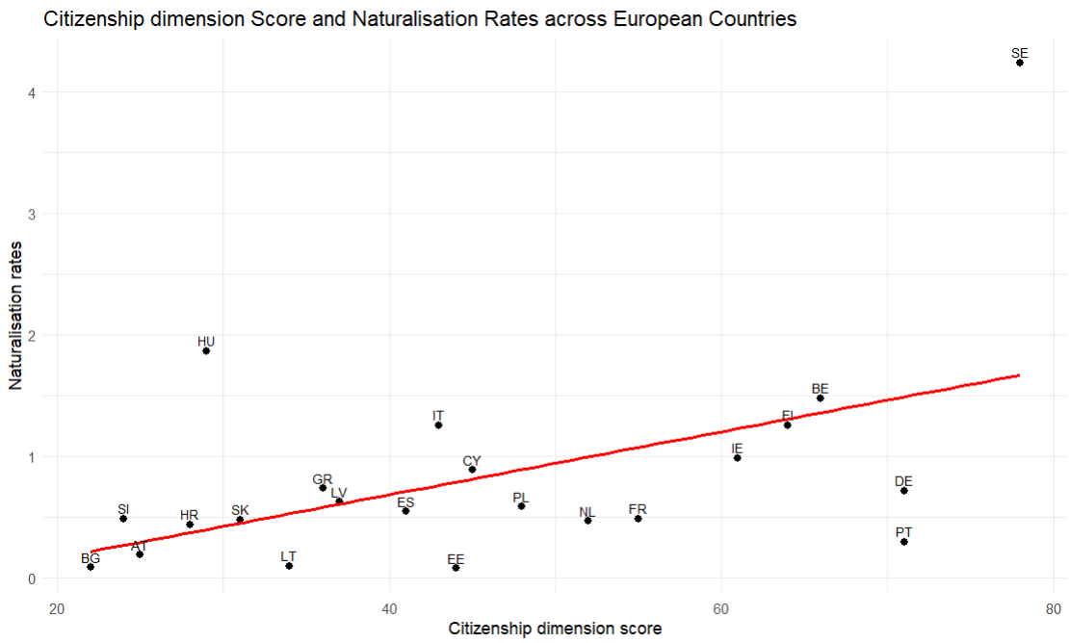
Analysis
Citizenship Dimension and Naturalisation rates
EU Citizens

Slide 18
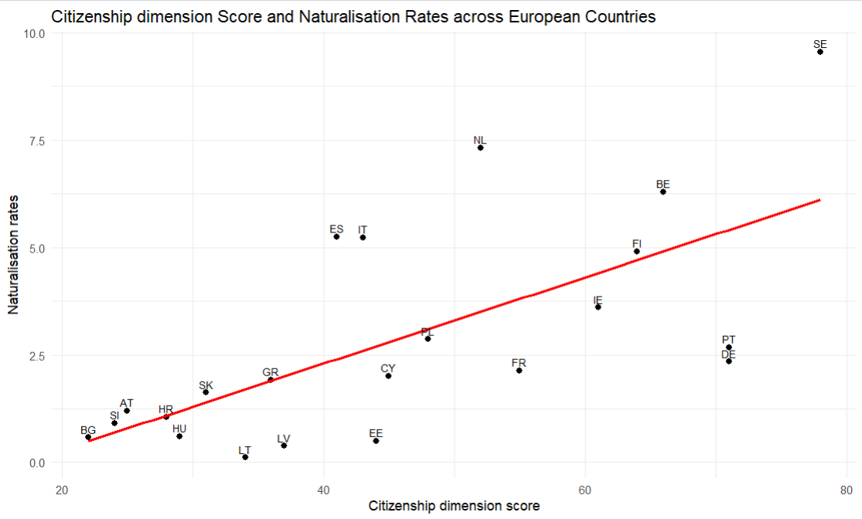
Analysis
Citizenship Dimension and Naturalisation rates
Non-EU Citizens

Slide 19
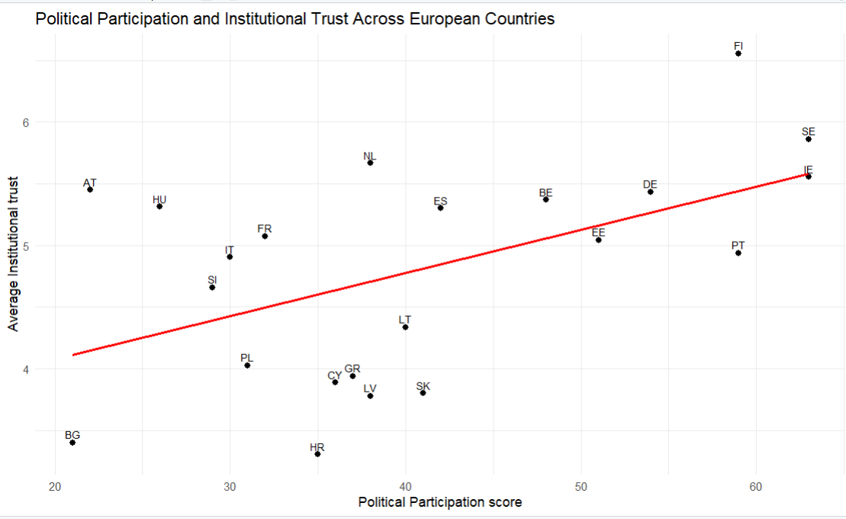
Analysis
PPP Index and Institutional Trust

Slide 20
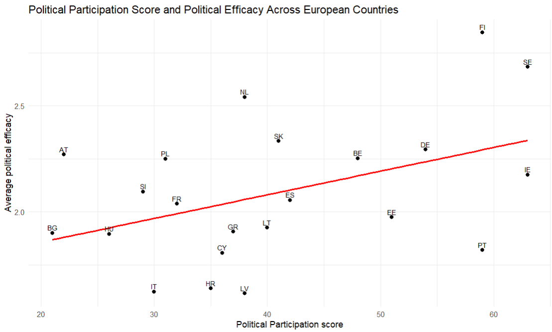
Analysis
PPP Index and Political Efficacy

Slide 21
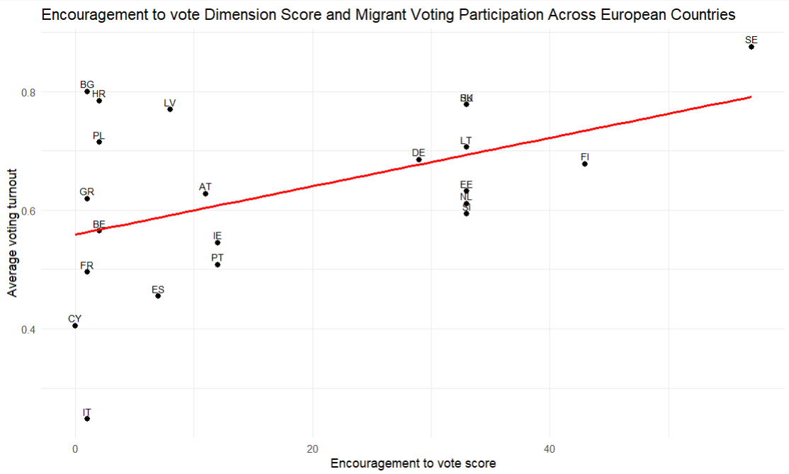
Analysis
Encouragement to Vote Dimension and Voting

Slide 22
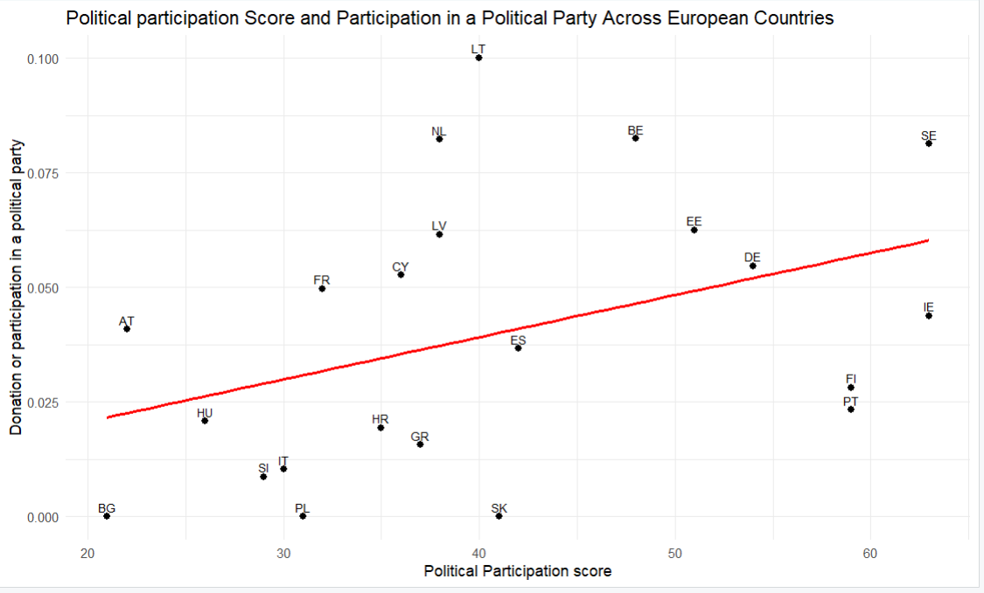
Analysis
PPP Index and Participation or donation to a political party
or pressure group

Slide 23
Overall Findings
Higher-scoring countries on the PPP Index tend to have higher naturalisation rates, particularly among non-EU citizens.
More inclusive policy environments are positively associated with higher levels of institutional trust and political efficacy among migrants.
The relationship between political participation policies and electoral participation is more mixed:
  Policies encouraging voting are strongly associated with higher migrant voter turnout but voting rights and favourable citizenship policies alone do not consistently translate into higher electoral participation.
There is a positive association between inclusive policy frameworks and non electoral activities:
  Policies that support migrant-led civil society, protect civic freedoms, and enable collective engagement appear particularly relevant for fostering non-electoral forms of participation.

Slide 24
Recommendations
1. Develop comprehensive national strategies on migrant political participation
  Clearly define objectives
  Dedicated budgets
  Identify responsible institutions
  Monitoring & evaluations frameworks
2. Lower structural and administrative barriers to citizenship
  Reduce requirements
  Shorten waiting periods & improve transparency
  Legal and administrative support
3. Expand voting rights and meaningful participation
  Automative & Simplified voter registration
  Clear & multilingual information
  Equal access to infrastructure & Information

Slide 25
Recommendations
4. Prioritise encouragement to vote
  Targeted voter outreach campaigns for migrants
  Local authorities, migrant organisations, and leaders’ engagement
  Inclusive campaigns for vulnerable groups
5. Strengthen civic education for a diversifying society
  Inclusive civic education into school curricula
  Adult civic education programmes
  Combine institutional information with practical knowledge
  Partner with civil society actors for community-based civic learning
6. Support migrant-led civil society as a pillar of political participation
  Stable & multi-year funding
  Ensure funding does not discourage advocacy or political expression
  Migrant organisations’ access to policymaking
  Capacity-building in leadership, policy advocacy, and organisational sustainability

Slide 26
Recommendations
7. Protect and expand civic space & collective participation rights
  Freedom of expression, association, and peaceful assembly
  Remove barriers to migrant participation in protests, unions, and advocacy groups
  Public authorities’ engagement with protest and civic mobilisation
8. Promote representation of migrants in political & institutional life
  Inclusive recruitment and candidate selection practices
  Mentoring, leadership, and training programmes for candidates with migrant backgrounds
  Reduce legal or administrative barriers to standing for election
  Diversity within public administration and advisory bodies
9. Address administrative data gaps
  Collect and publish disaggregated data on political participation
  Harmonise definitions of “migrant”
  Expand administrative data collection to include participation outcomes
  Data protection and prevention of information misuse

Slide 27
Recommendations
10. Integrate administrative and survey data through coordinated data strategies
  Combining administrative records with high-quality survey data
  Supporting oversampling of migrant populations in large-scale surveys
  Encouraging longitudinal data collection to track participation trajectories over time
11. Embed migrant political participation in broader democratic governance agendas
  Mainstream participation objectives into democracy, rule of law, and equality strategies
  Recognise migrant participation as a driver of democratic legitimacy and resilience
  Frame political inclusion as an investment in social cohesion and democratic sustainability

Slide 28

Research Team of the Political Participation Index & MIPEX Research Team
Başak Yavçan, PhD
Alexander Wolffhardt
Sinem Yılmaz, PhD
Stefano Deodati
Thomas Huddleston, PhD
Shabnam Kherzi
Costanza Hippoliti
Marianna Gorgerino
Anna Igranaissi

Slide 29
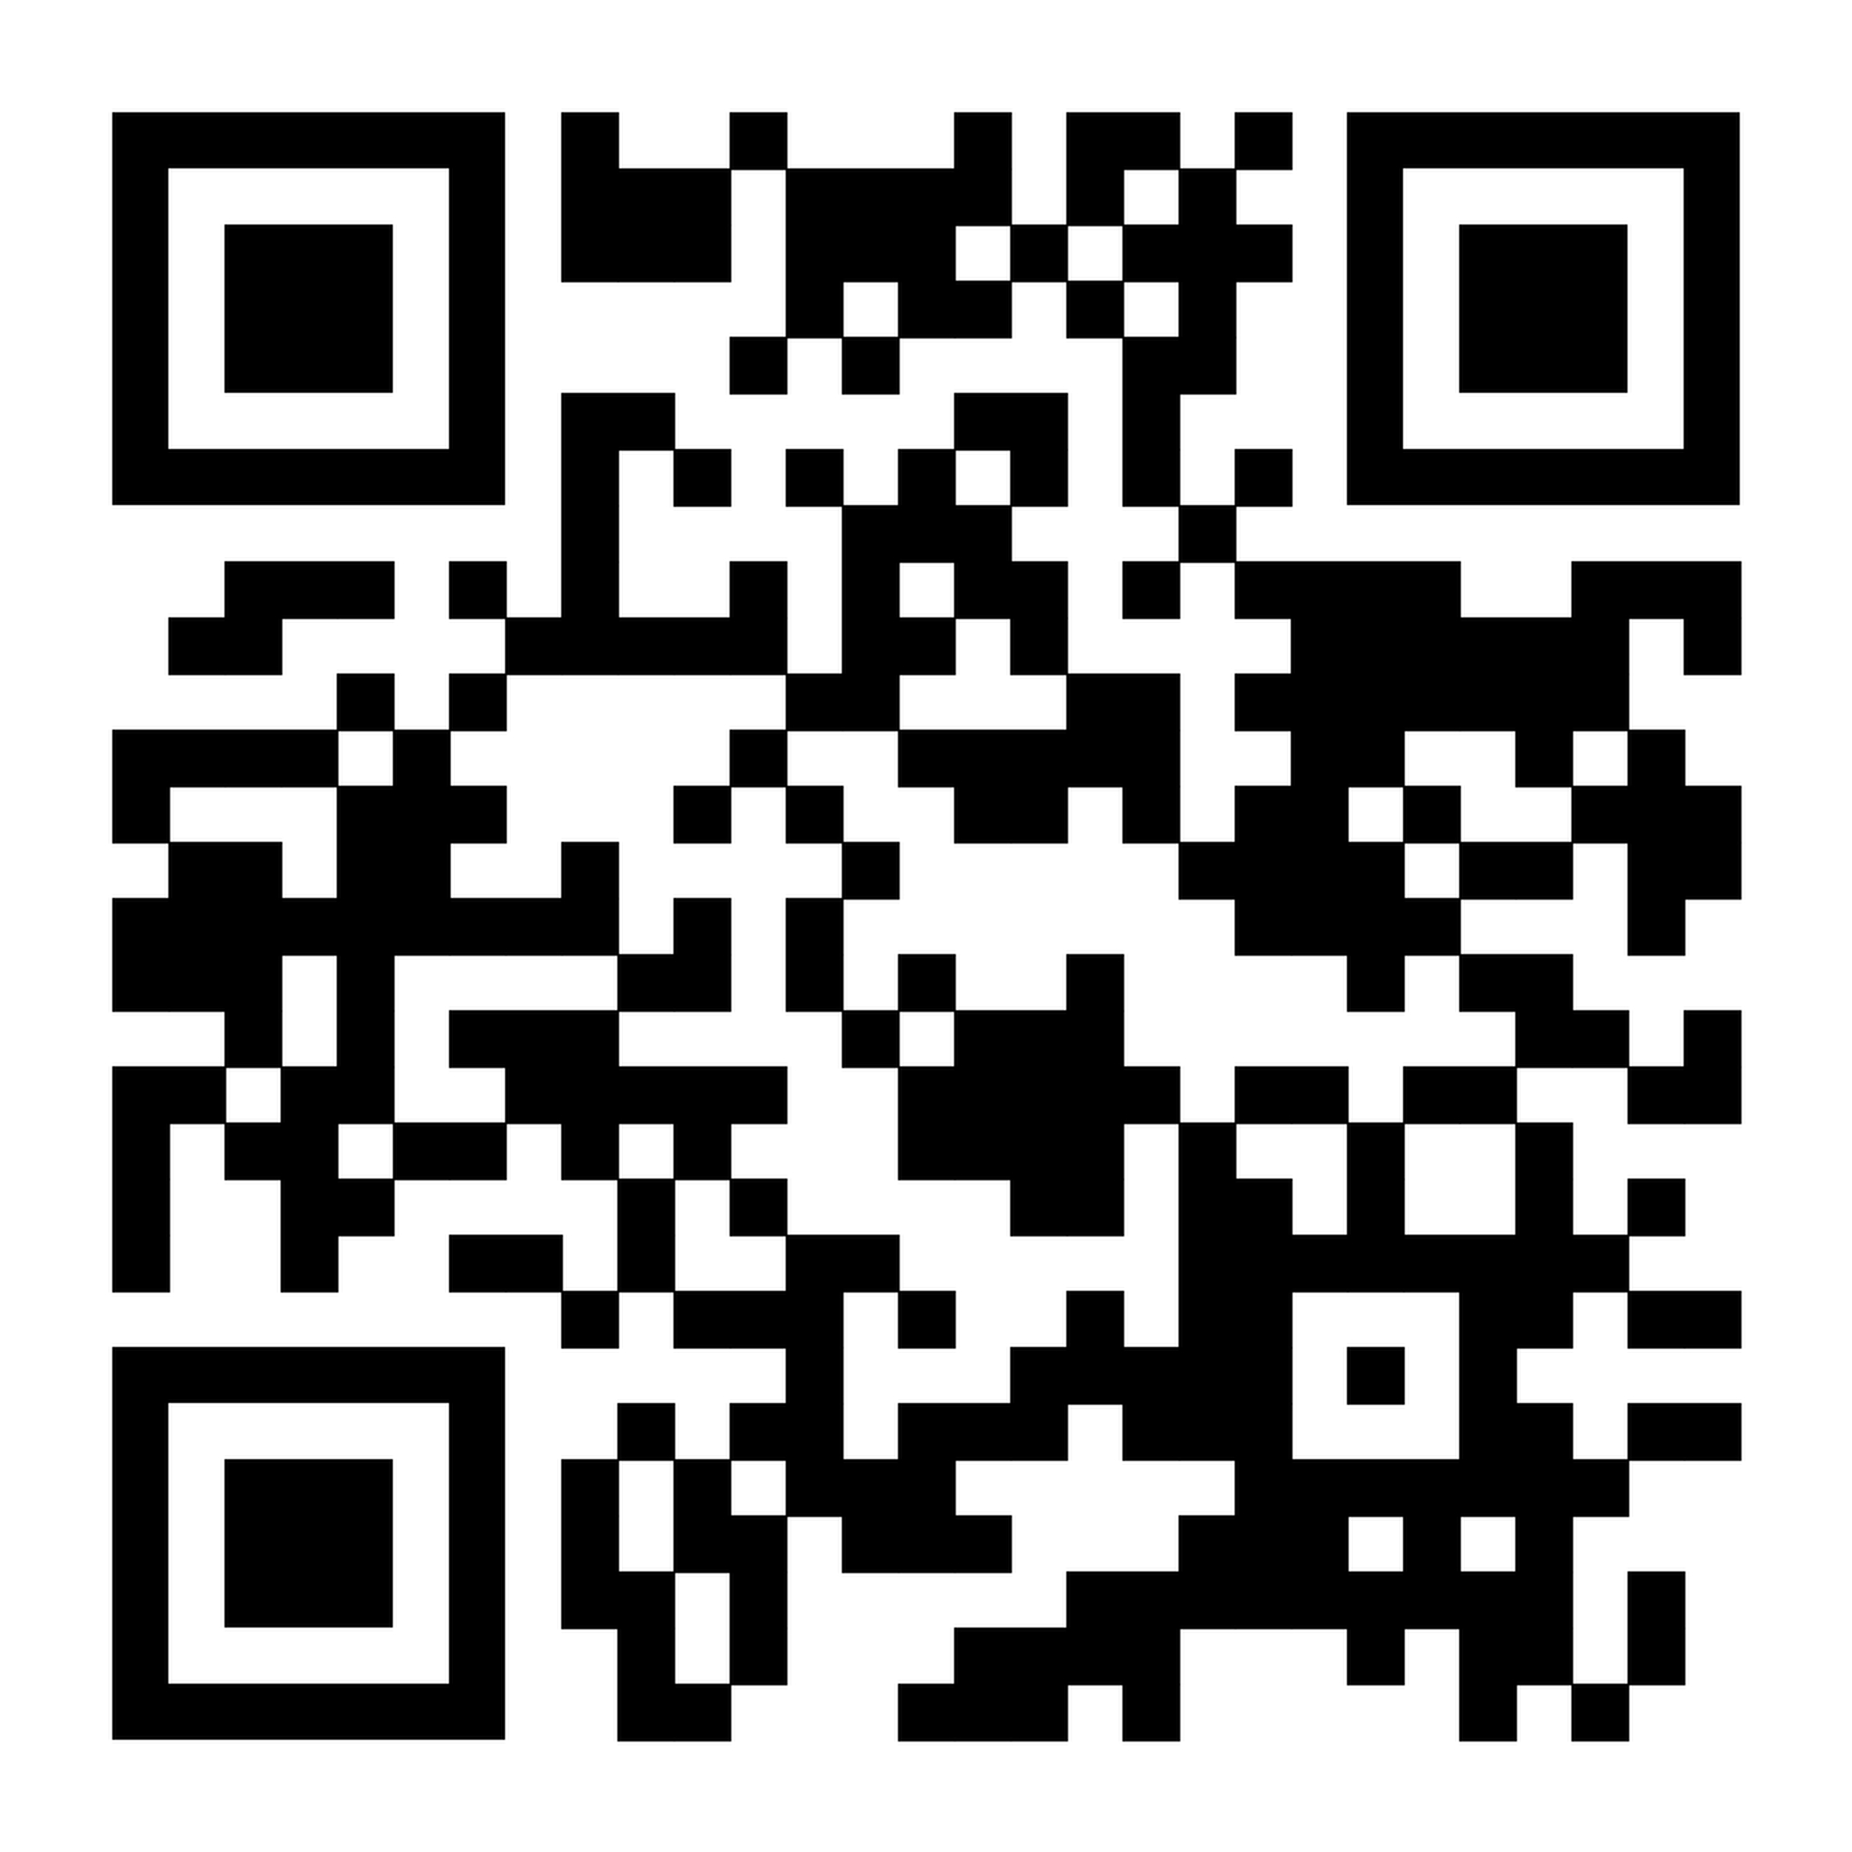
Useful sources:
Political Participation Index
Report
MIPEX 2025 Comparative Report

Slide 30

THANK YOU!

Slide 31
Data on electoral participation (2023 onwards)

Slide 32
Data on electoral participation (2023 onwards)

