Slide 1


MIPEX – SPAIN Country Launch
Başak Yavçan, PhD
Head of Research
Migration Policy Group
Francesco Pasetti
Research Fellow in Migration
CIDOB
Notes:
BY, MIPEX (2025 wave) (traducción)

Slide 2
Outline
Introducing MIPEX
Comparative Results, Preliminary Findings
Data trends and EU Comparison
Labour integration policies and processes in Spain

Slide 3
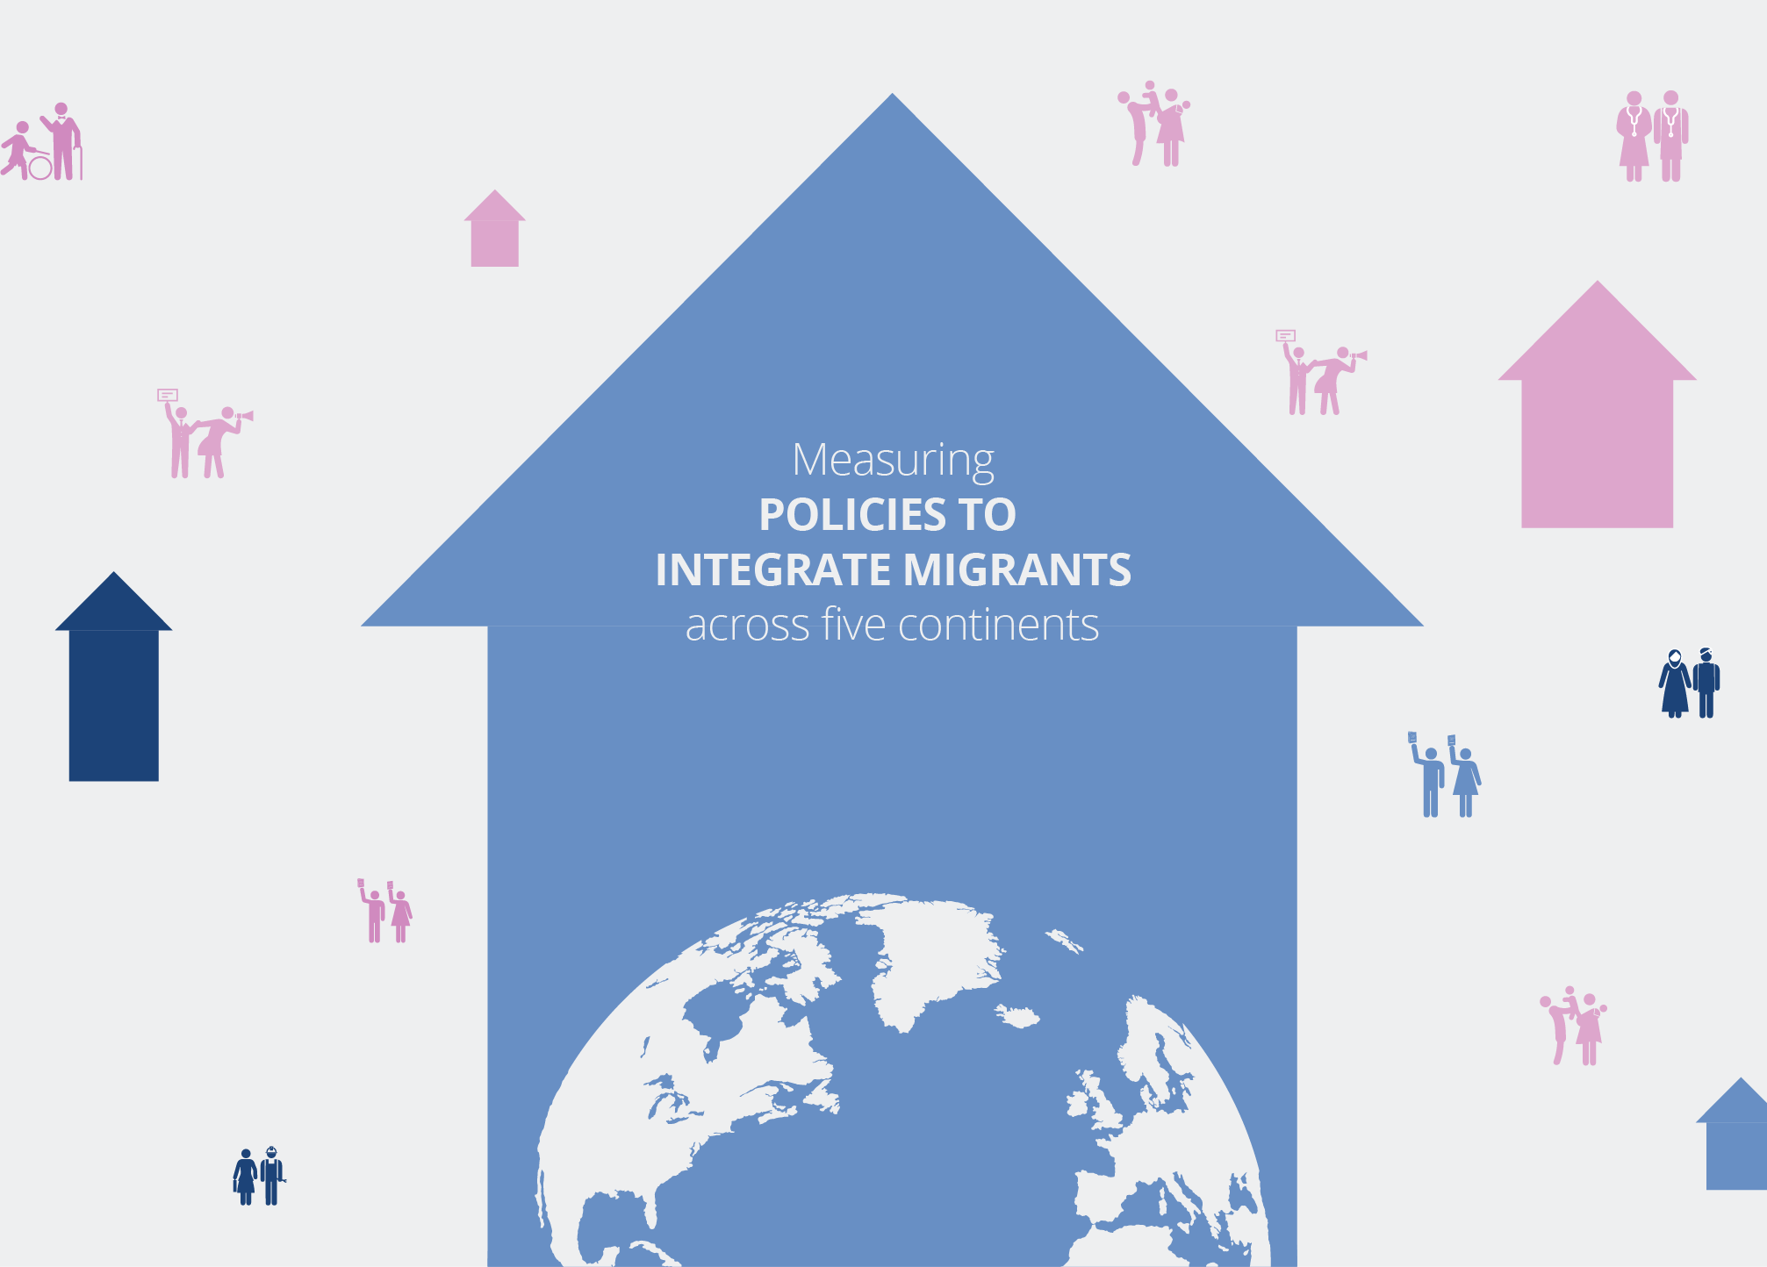


Slide 4
What is MIPEX?
  Comprehensive tool to compare integration policies:
  Longitudinal scope (2007-2023)
  Thematic scope (8 policy areas, e.g., labour market, education, access to nationality, health etc.)
  Target group: international migrants (non-citizens): migrant workers, family reunited migrants, permanent residents
  Geographic scope (52 countries in 2019)
  Methodology with national experts & checks
  58 Indicators
  Most cited international benchmark by policymakers, NGOs, media & research
  Example: Draft Global Compact on Migration

Slide 5
What is MIPEX?
  MPG works in collaboration with national experts from each country.
  Experts are tasked with conducting research on integration policies of their own country, with a particular focus on recent policy changes.
  They complete a detailed questionnaire, providing comments to justify their responses and highlighting policy changes.
  MPG conducts an initial review of the submissions to ensure accurate interpretation of the questions and consistency across countries.
  MPG holds individual meetings with each expert to verify consistency and clarify any issues.
  Final scores are then discussed and agreed upon collaboratively.

Slide 6
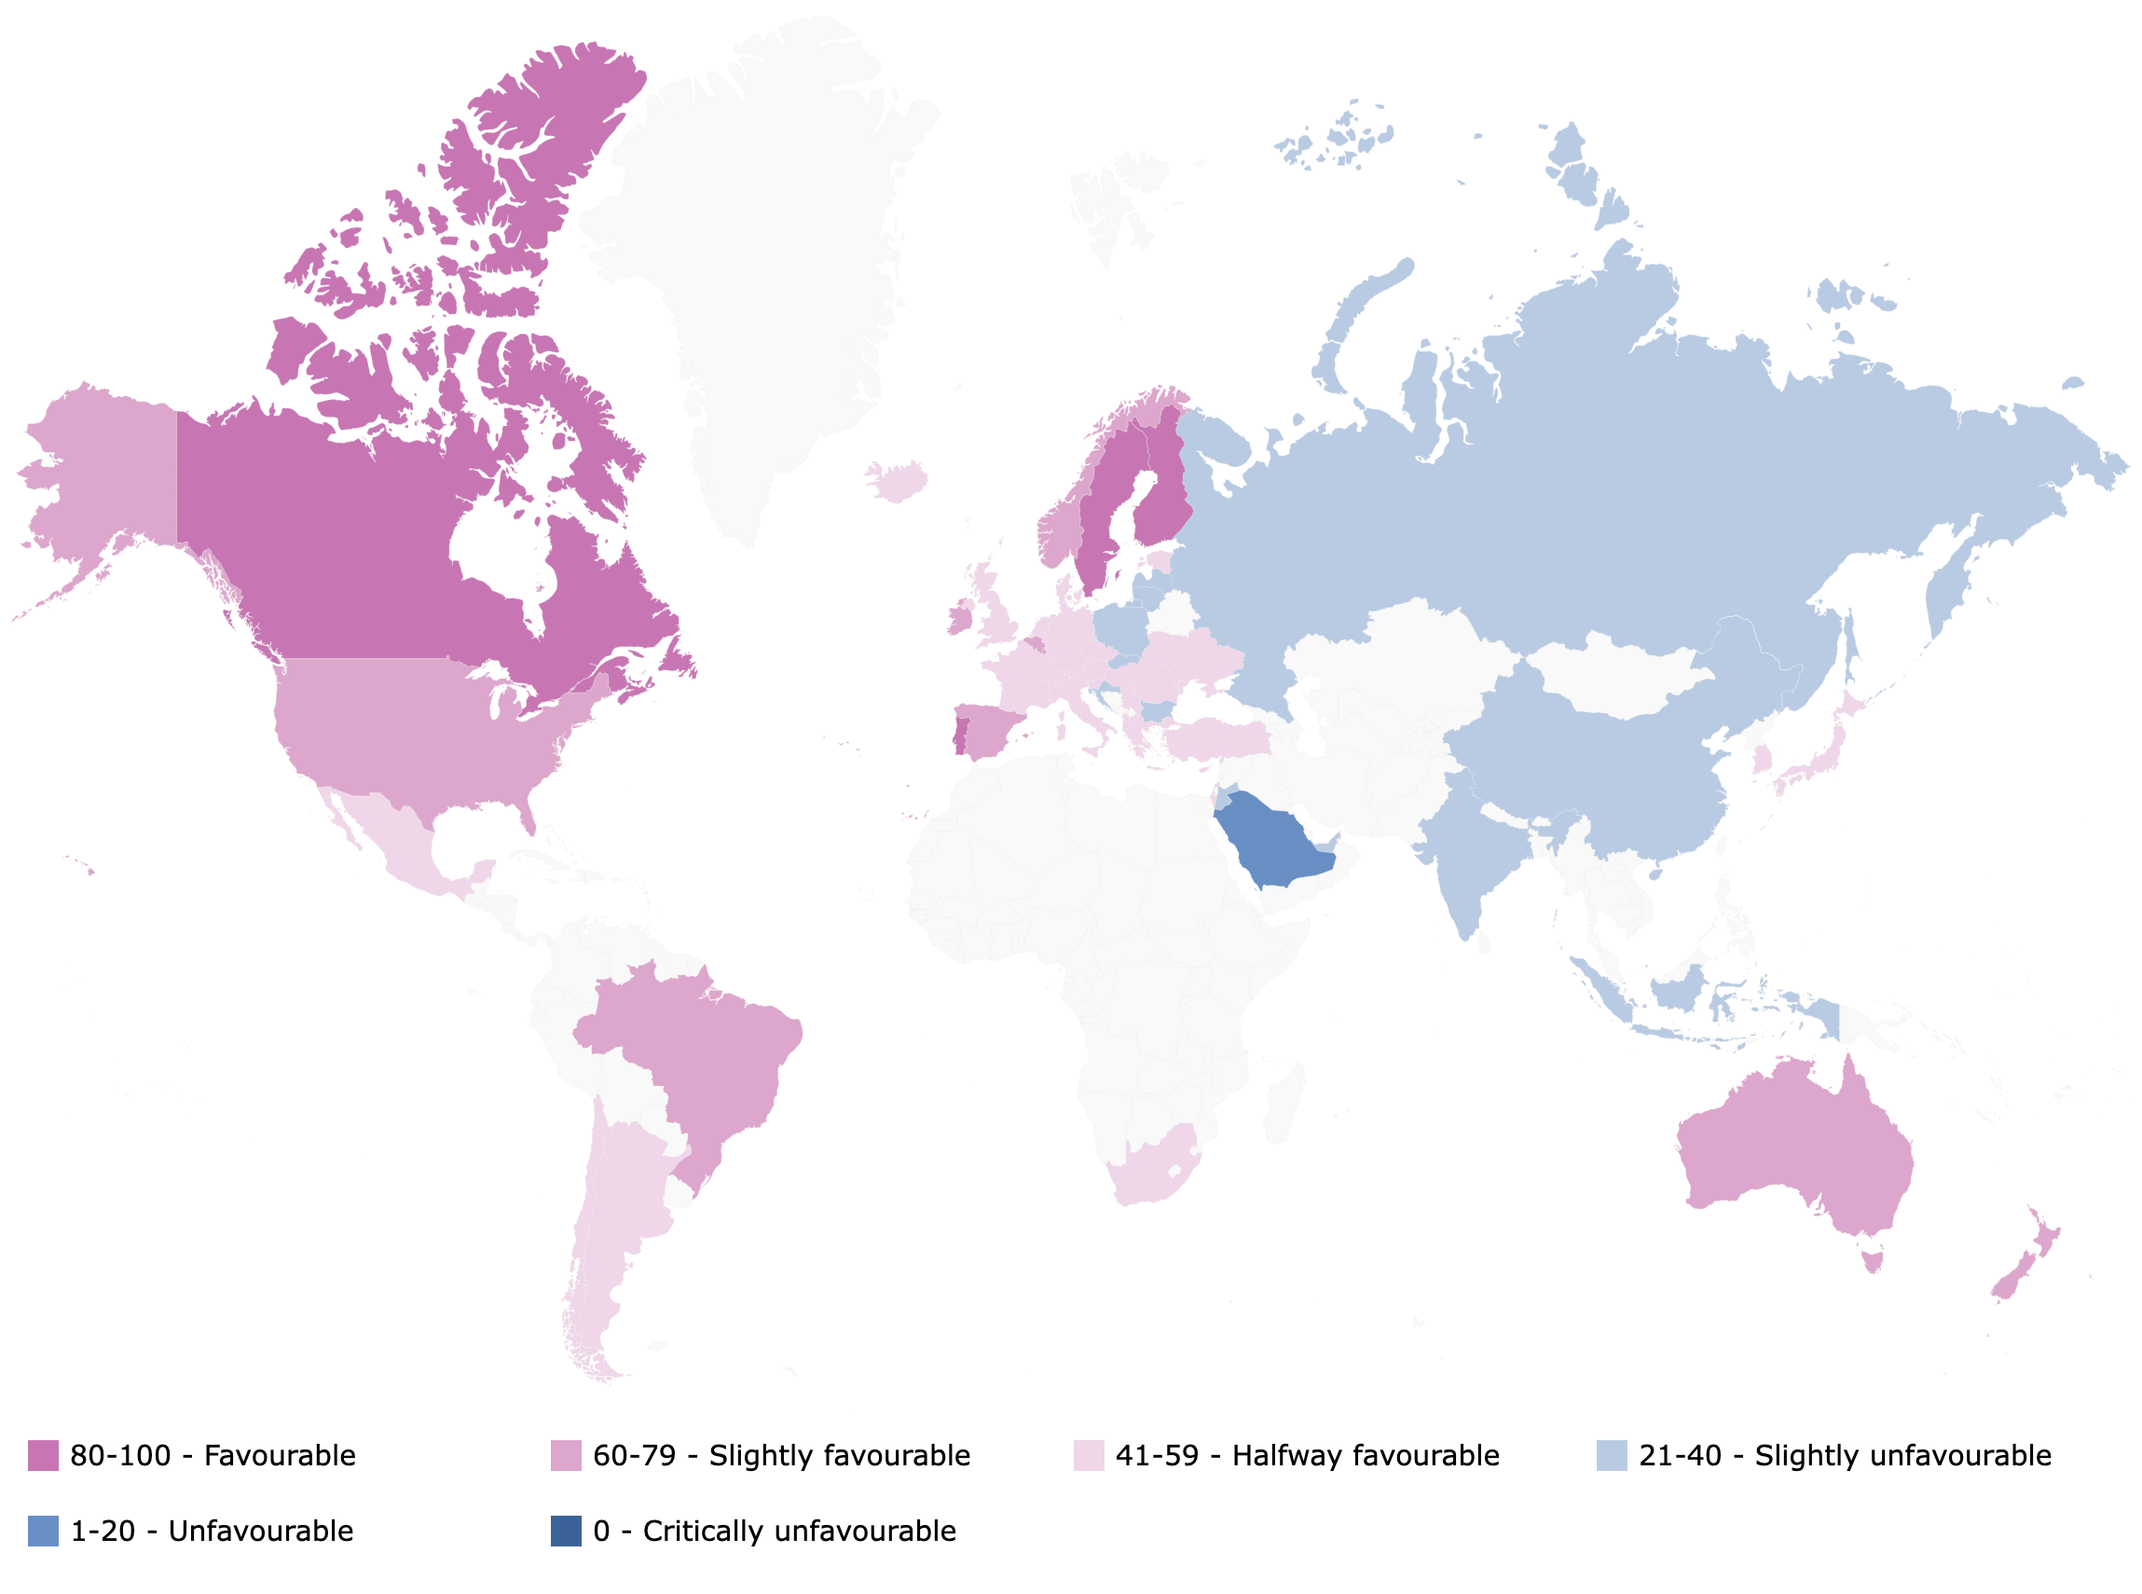
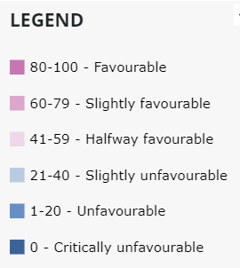
MIPEX COMPARATIVE FINDINGS - 2019

Slide 7
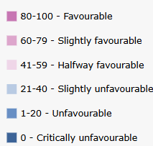
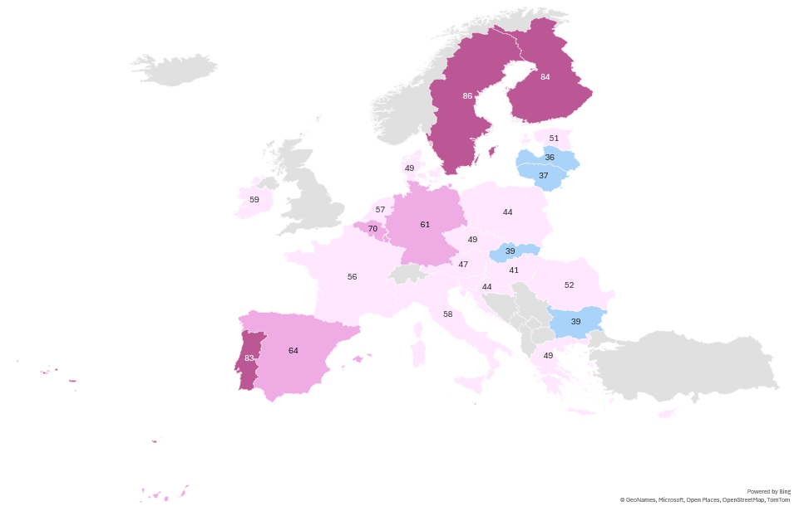
MIPEX EU 2023/2024

Slide 8
How does Spain Measure up
(2024)

Slide 9
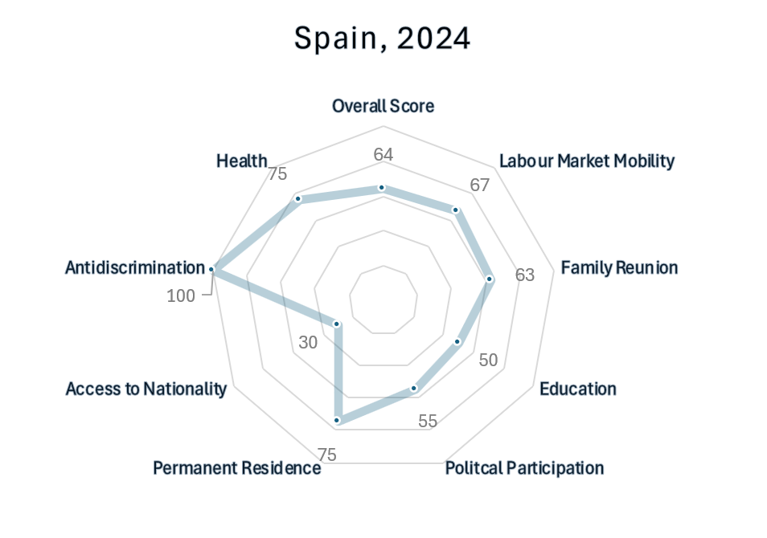
Spain
MIPEX Policy Areas 2023
Legend
80-100 | Favourable
60-89 | Slightly favourable
41-59 | Halfway favourable
21-40 | Slightly unfavourable
1-20 | Unfavourable
0 | Critically unfavourable

Slide 10
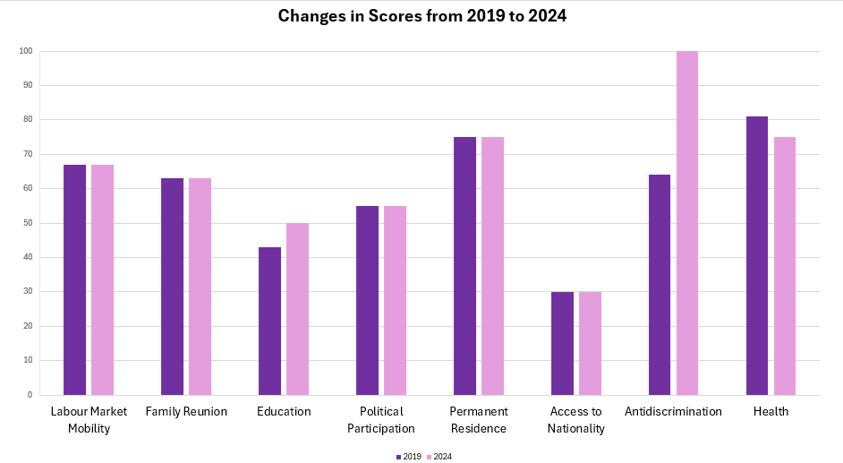
-6
Changes from 2019 to 2024
+36
+7

Slide 11
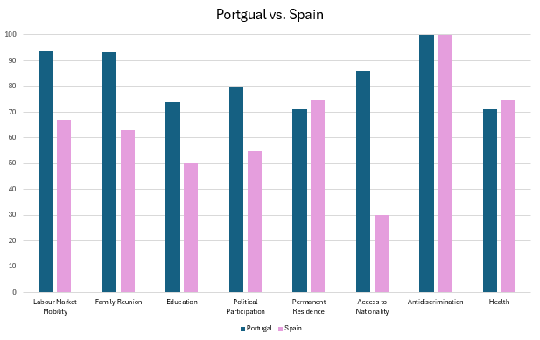
How does Spain measure up?
Overall scores (latest update):
Spain: 64
Portugal: 83

Slide 12
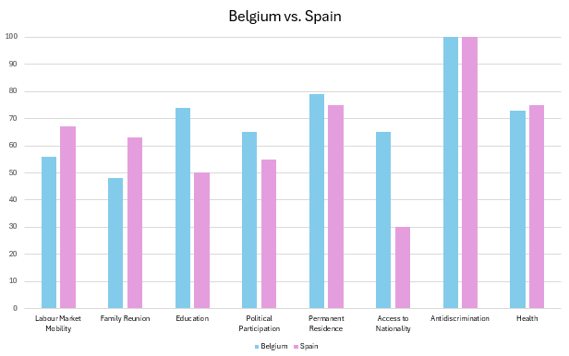
How does Spain measure up?
Overall scores (latest update):
Spain: 64
Belgium: 70

Slide 13
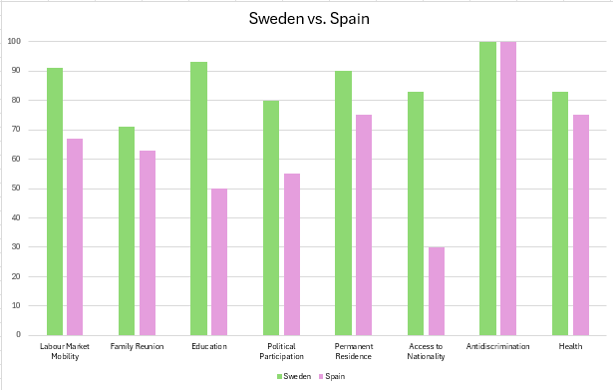
How does Spain measure up?
Overall scores (latest update):
Spain: 64
Sweden: 86

Slide 14
Key insights (+ 4 points in the overall score since 2019)
Some improvements, mainly in antidiscrimination and education
  New comprehensive non-discrimination law in 2022
  Greater diversity reflected in school curriculum
Reduced involvement of migrants in healthcare
New Immigration Regulation (Royal Decree 1155/2024), establishing structured legal pathways to integration, particularly in education and labour market mobility:
  Socio-Labour Arraigo
  Socio-Formative Arraigo
  Second-Chance Arraigo

Slide 15
Conclusions
Overall MIPEX Score: 64/100, slightly favourable approach to integration
Immigrants in Spain enjoy more opportunities than obstacles when it comes to integration
Spain promotes a comprehensive approach to integration, but not yet fully favourable
Immigrants can enjoy many of the same basic rights as Spanish citizens, but integration policies only go halfway towards securing equal opportunities for non-EU citizens:
  they encourage the public to see immigrants as equals, but not necessarily as their future fellow citizens or neighbours
Major obstacles make the path to full citizenship challenging for many immigrants, limiting their long-term integration into society

Slide 16
THANK YOU!

Slide 17


Başak Yavçan, PhD. Migration Policy Group
Email: byavcan@migpolgroup.com

Slide 18
MIPEX Research Team of 2024 Update
Başak Yavçan, PhD
Alexander Wolffhardt
Mojib Atal, PhD
Marianna Gorgerino
Stefano Deodati
Thomas Huddleston, PhD
Shabnam Kherzi
Costanza Hippoliti
Anna Igranaissi
Country Expert: Francesco Pasetti

Slide 19
Labour integration policies and processes in Spain
Outline
Recent policy changes in migrant labour integration
  Migrant labor market integration in Spain: traits, trends, challenges & policy leverage
  Key issues for the debate
Notes:
Zoom-in: general and comparaitve → to labour market context
Policy changes after mipen

Slide 20
Recent policy changes in migrant labour integration
Reform of the Immigration Regulation (RD 1155/2024)
Improving access to and conditions of residence and work: legal status; skills shortages; transitions to work; qualified labour
  Job‑search visa: children/grandchildren of Spaniards; specific occupations and territories
  Long‑term study and training permits
  Seasonal individual work permits (complementing GECCO)
  Arraigo: reform types (sociolaboral, social, familiar, socioformativo) & new (segunda oportunidad) → work
- Positive impact (early evidences), but implementation challenges remains (arraigo sociolaboral; socioformativo)
Regularization (2026)
Undocumented migrants and Asylum seekers (before 31.21.2025) → 1-year residence and work permit (renewable)
Potential beneficiaries: 0,5-1 million people
Expected impact: social equality; economic and fiscal impact; labour market
Notes:
comprehesive overhal of entry, saty and return rules and conditions;
Favoerce accesso a la situación irregualr a la vez facilitar le proceso de integración laboral: regularidad administrativa como condición de acceso
Mercado laboral eje central del proceso; ← historical pivotal role of Trabajo y mercado en la integracion migrant; Pragmatic policy approach: market-driven; granting equal access; no target-policy; irregular workforce.

Slide 21
Migrant labor market integration in Spain: traits and trends
High Quantity: Scale and Economic Relevance
Size and relevance of migrant workforce: 80% of new jobs in 2024; 21% of active workforce (women!)
Indispensable in key sectors: care, agriculture, hospitality, delivery, construction and related services
Systemic contribution: direct and indirect economic and fiscal impact
  Low Quality: Unequal and Precarious Labour Market Integration
  Lower wages: migrants earn systematically less than native workers (women!)
  Concentration in low(er)-skilled jobs ← lower education levels; but also overqualification (1/3 vs 1/4 of natives)
  Higher unemployment: long-term (1/3 vs 1/6 of natives); combined with lower access to unemployment-related benefits
  Precarious employment patterns: higher incidence of temporary and part-time contracts
  Irregular employment: significant share of workers without valid residence permits and/or formal labour contracts
  Barriers to access and training: additional obstacles to labour market entry and limited access to vocational training
  Precarity: higher exposure to exploitation, poverty, and multidimensional precarity (housing, health, material conditions)
Notes:
Nos dice mucho sobre migrantes; mercado trabajo; modelos de gobernaza econmica y prpductiva española.

Slide 22
Migrant labor market integration: challenges & policy leverage
Key Challenges
Labour market segmentation: occupational downgrading, precarious contracts, and concentration in low‑value sectors
Supply–demand mismatch: insufficient alignment between training systems, public employment services, and employers’ needs
Downward occupational mobility: barriers to qualification recognition, skills validation, and access to training
Administrative and governance bottlenecks: limited capacity, slow and uneven procedures, and fragmented multi‑level governance
Irregularity and rights gaps: exposure to informal work, exploitation, and reduced access to social protection
Policy Levers
Strategic legal framework: beyond regulatory reforms towards a coherent framework combining mainstream and targeted policies
Implementation and Funding Mechanisms: enhance resources, multi‑level coordination, and more solid funding mechanisms
Skills and employability alignment: integrate training, faster recognition of qualifications, skills and experience, to improve matching
Rights enforcement and job quality: stronger labour inspection and equal working conditions and protections
Political consensus and continuity: wider and long-tern stakeholders’ consensus, beyond politicization

Slide 23
Key issues for the debate
Diagnostic
From your experience, which elements of the current labour market integration process for migrants in Spain are working well, and which ones currently represent the main bottlenecks or system failures?
Desde su experiencia, ¿qué elementos del actual proceso de integración laboral de las personas migrantes en España están
funcionando bien y cuáles representan hoy los principales cuellos de botella o fallos del sistema?
Forward-looking / policy-oriented:
Looking ahead to how these processes could be improved, which policy changes or institutional design reforms should be prioritised to move towards more effective and fair labour market integration? Which good practices, concrete examples or lessons learned could serve as references for Spain?
Pensando en cómo mejorar estos procesos, ¿qué cambios de política o de diseño institucional serían prioritarios para avanzar hacia una integración laboral más eficaz y justa? ¿Qué buenas prácticas, ejemplos concretos o lecciones aprendidas podrían servir de referencia en España?
Notes:
ión
concertada con entidades
sociales sin ánimo de
lucro y sus desafíos
La colaboración complementaria del tercer sector de acción social, que no puede diluir la respon-
sabilidad de las Administraciones públicas, afronta varios problemas estructurales, organizativos
y de financiación, que obstaculizan la efectividad de los programas y la protección de las personas
inmigrantes.

Slide 24
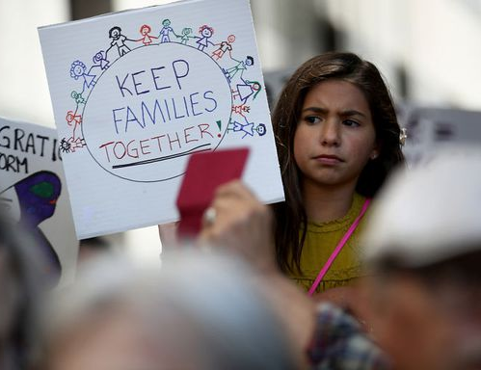

Family reunification
Policies allowing many immigrants to reunite with their children and spouse after 1 year of residence
  But definitions of dependency for parents, grandparents, and adult children are restricted
No integration or language requirement for reunification
Strict economic conditions
Partners and children are entitled to autonomous residence
  But broad grounds for rejecting, withdrawing, or refusing to renew their status

Slide 25

Education: changes in 2024 (+7 points)
Growing number of immigrant pupils can legally access all levels of compulsory education
No targeted measures in place to increase access to higher education and educational guidance
Limited support to learn the language
Organic Law 3/2020: highlights the importance of diversity in school curricula, requiring education for global citizenship (peace, human rights, international understanding and intercultural education) in compulsory education programmes.

Slide 26

Political participation
Immigrants are more likely to participate politically by circumventing official channels
  Inconsistent voting policies & limited funding for national immigrant bodies and information campaigns
Forum for the Social Integration of immigrants: consultative body that informs and channels actions to promote migrant participation and integration, providing regular and structured consultation with immigrant populations.

Slide 27

Permanent residence
Policies mostly unchanged since 2011
Most non-EU citizens can benefit from inclusive process for long-term residence, eligible to apply after 5 years
Permanent residents have access to social security and assistance
Non-EU immigrants will lose their permanent residence status if they are absent from the country or 12 consecutive months or more than 30 months within a 5-year period

Slide 28

Access to nationality
Naturalisation process continues to be a main area of weakness
Immigrant can become citizens after 10 years of residence
Dual citizenship is only granted to those from certain countries
Latest improvement in 2015: language and economic requirements slightly eased
Integration requirements continue to be strict and include knowledge of the Spanish Constitution and the country’s social and cultural realities

Slide 29


Anti-discrimination:
changes in 2024 (+36 points)
New comprehensive law on equal treatment and non-discrimination in 2022
  Broadens the prohibited grounds of discrimination to include ethnicity, religion, and nationality, across multiple fields (employment, education, social protection, and access to public goods and services)
  Strengthen enforcement mechanisms & methods to evaluate anti-discrimination measures
  Establishment of new State Authority for Equal Treatment and Non-Discrimination, replacing CEDRE, with an expanded mandate to combat discrimination

Slide 30


Health: changes in 2024 (-6 points)
Since 2018, no legal or economic obstacles to healthcare for immigrants
Responsive healthcare services and proper information on healthcare rights
Still, administrative barriers
Decline in the involvement of migrants in information provision and service design & delivery
  No systematic involvement in research evaluation, and planning related to healthcare

Slide 31
MIPEX
2024
Labour
Market

Slide 32
MIPEX
2024
Family
Reunion

Slide 33
MIPEX
2024
Education

Slide 34
MIPEX
2024
Political
Participation

Slide 35
MIPEX
2024
Permanent
Residency

Slide 36
MIPEX
2024
Access to
Nationality

Slide 37
MIPEX
2024
Anti-discrimination

Slide 38
MIPEX
2024
Health

