Slide 1

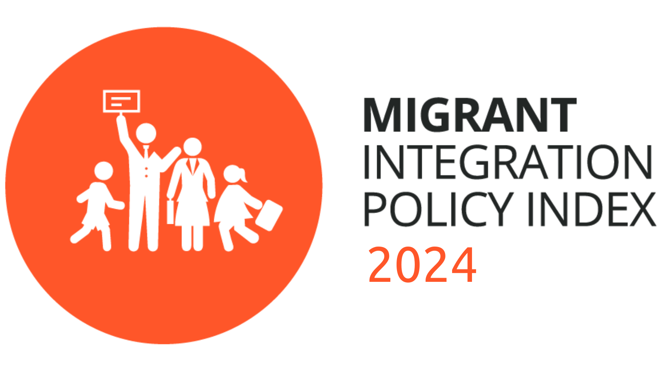
MIPEX Cyprus
Başak Yavçan, PhD
Head of Research
Migration Policy Group

Slide 2
What is Migrant Integration Policy Index MIPEX?
  Comprehensive tool to compare integration policies:
  Longitudinal scope (2007-2023)
  Thematic scope (8 policy areas, e.g., labour market, education, access to nationality, health etc.)
  Target group: international migrants (non-citizens): migrant workers, family reunited migrants, permanent residents
  Geographic scope (52 countries in 2019)
  Methodology with national experts & checks
  58 Indicators
  Most cited international benchmark by policymakers, NGOs, media & research
  Example: Draft Global Compact on Migration

Slide 3
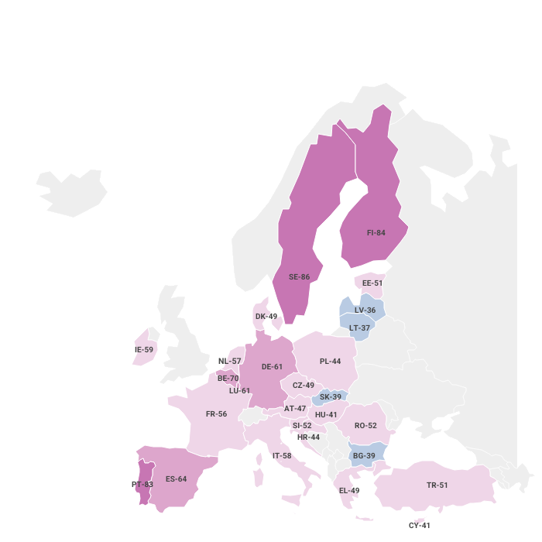
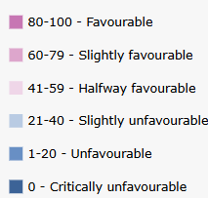
MIPEX EU 2023/2024

Slide 4
Cyprus
MIPEX Policy Areas
2025
Legend
80-100 | Favourable
60-89 | Slightly favourable
41-59 | Halfway favourable
21-40 | Slightly unfavourable
1-20 | Unfavourable
0 | Critically unfavourable

Slide 5
Key insights
Over the past five years, Cyprus’s approach to migrant integration has remained largely unchanged.
Since 2014, no significant measures to address weaknesses in integration.
Some progress in labour market: permanent residents and those granted family reunification can now access public employment services.
  Does not extend to all migrant groups
Recent negative development in 2023: introduction of economic requirements for naturalisation
2024: Adoption of 50-point State Action Plan aimed at enhancing the integration of TCNs, structured around 5 pillars (education, health, housing, employment and skills) to ensure equitable access to services and participation in labour market
CSOs have still expressed concern on gaps in: family reunification, long-term residency, naturalization, and on implementation of integration measures

Slide 6
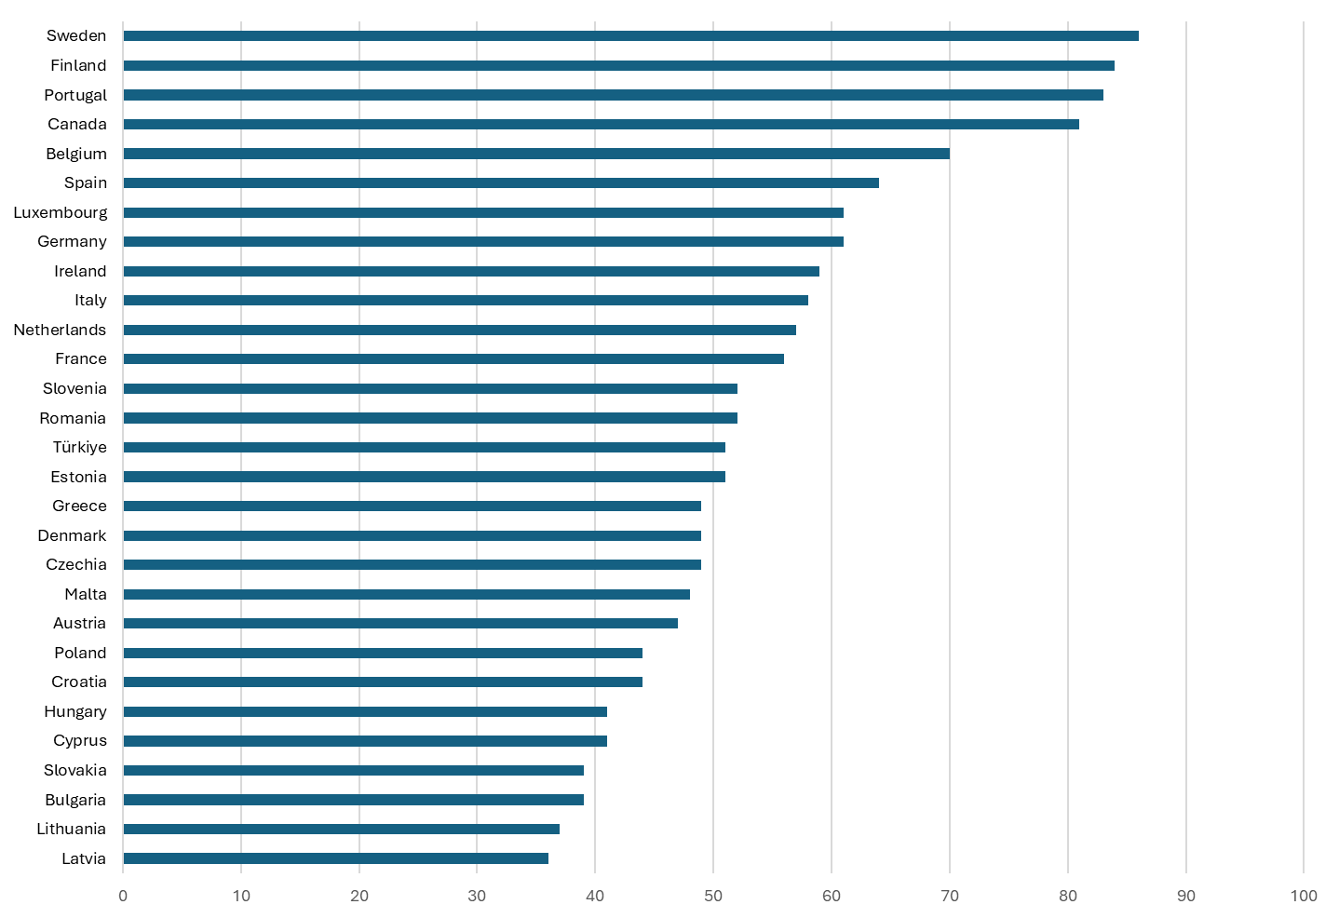
How does Cyprus Measure up

Slide 7
MIPEX Cyprus Dimension: changes from 2019 to 2025

Slide 8


Labour market (30/100)
Slighlty unfavourable, major area of weakness weakness
Critical restriction of non-EU citizens’ access to labour market:
  face difficulties in changing jobs
  face major legal and language barriers to work in self-employment and in the public sector
  lack general and targeted support to improve their situation
Temporary residents do not get access to social security and assistance
EU Directive on Family Reunification (2003/86/EC): individuals under family reunification have the right to access public employment as permanent residents

Slide 9

Education (40/100)
Slightly unfavourable
All pupils (regardless of legal status) are entitled to access all types of schools & benefit from ongoing language support, targeted assistance and trained teachers
The Ministry of Education has taken steps for inclusive education by:
  developing a comprehensive guide on migrant education available in multiple languages
  DRASE programme: offering afternoon lessons, additional academic support, Greek language instruction
Significant gaps remain, particularly in facilitating access to higher education and establishing standardized guidelines for language instruction

Slide 10
THANK YOU!

Slide 11


Başak Yavçan, PhD. Migration Policy Group
Email: byavcan@migpolgroup.com

